Slide 1
ScienceDirect
User Quick Start Guide

Slide 2
Enabling efficient research for 21 years and counting, Elsevier’s ScienceDirect lets you explore wide-ranging subjects in:
Social Sciences and Humanities
Health Sciences
Life Sciences
Physical Sciences and Engineering
From basic science to current developments to novel research, researchers worldwide are downloading two million PDFs of relevant content each day from ScienceDirect.
A ScienceDirect subscription gives you access to 18 million full-text articles from over 2,650 journals and more than 42,000 book titles. With more than 1,400,000 open access articles at your fingertips, the next big step towards discovery is up to you!
Let’s get you started…

Slide 3
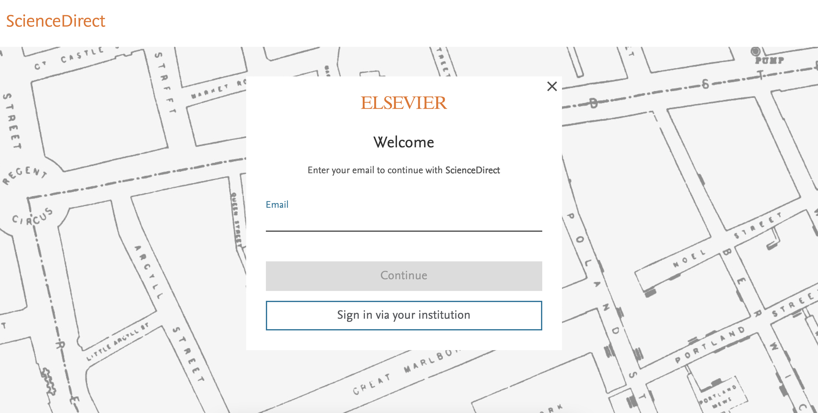
Create a user account
With an Elsevier account, you unlock features specifically designed to support your research goals. Having an account enables you to:
Set up alerts for searches, journals and book series
Receive recommendations personalized to your reading history
Access and manage your reading and search history
Review the privacy options for your account
Start screen on ScienceDirect to set up an Elsevier account

Slide 4
Search
Now that you’re on ScienceDirect, it’s time to look around.
The ScienceDirect search functionality offers a multitude of search fields, filters and alerts to focus your search and improve your workflow. First, choose the search technique you prefer.
If you want a broad search that you can filter afterwards, head to the search bar for a quick search:
Enter keywords, an author name, or the title of a journal or book to get started.

Slide 5
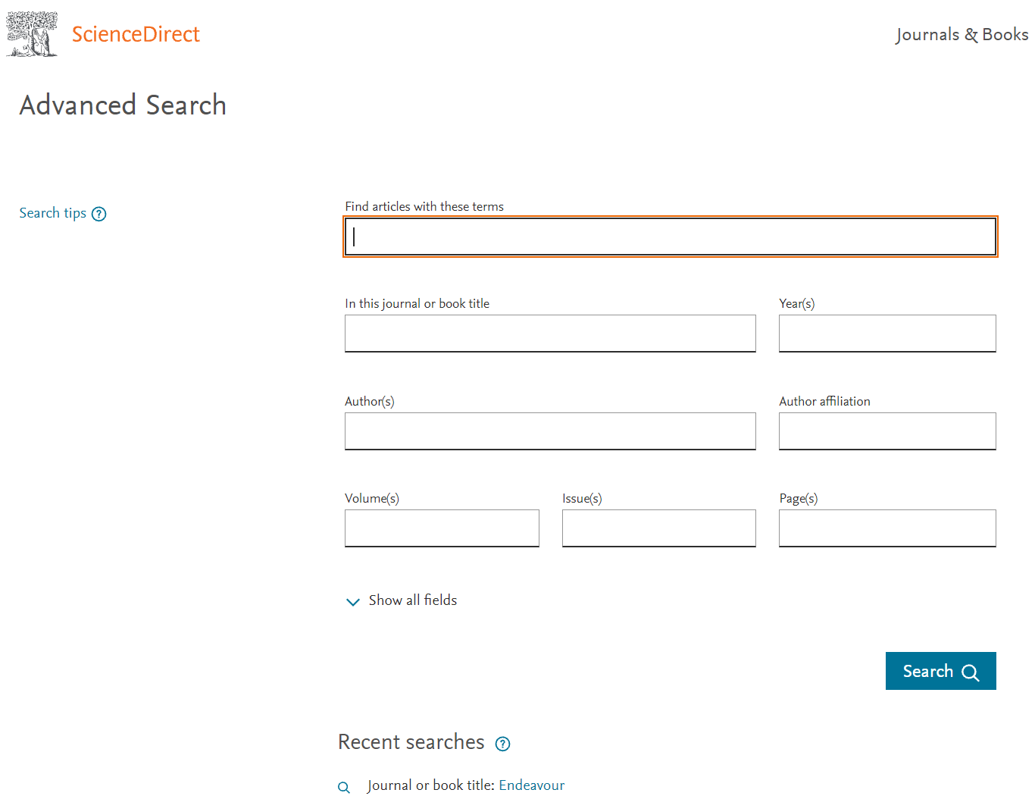
Search
You might want to begin with a narrow search instead, so click on Advanced Search where you’ll see how easy it is to get specific. Your previous searches will be conveniently saved for you at the bottom of the page.
On the Search results page, you can:
Filter for open access/open archives articles
Check out suggested publications
Set search alerts
Download search alerts list as a .CSV
View of filter tabs part of Advanced Search

Slide 6
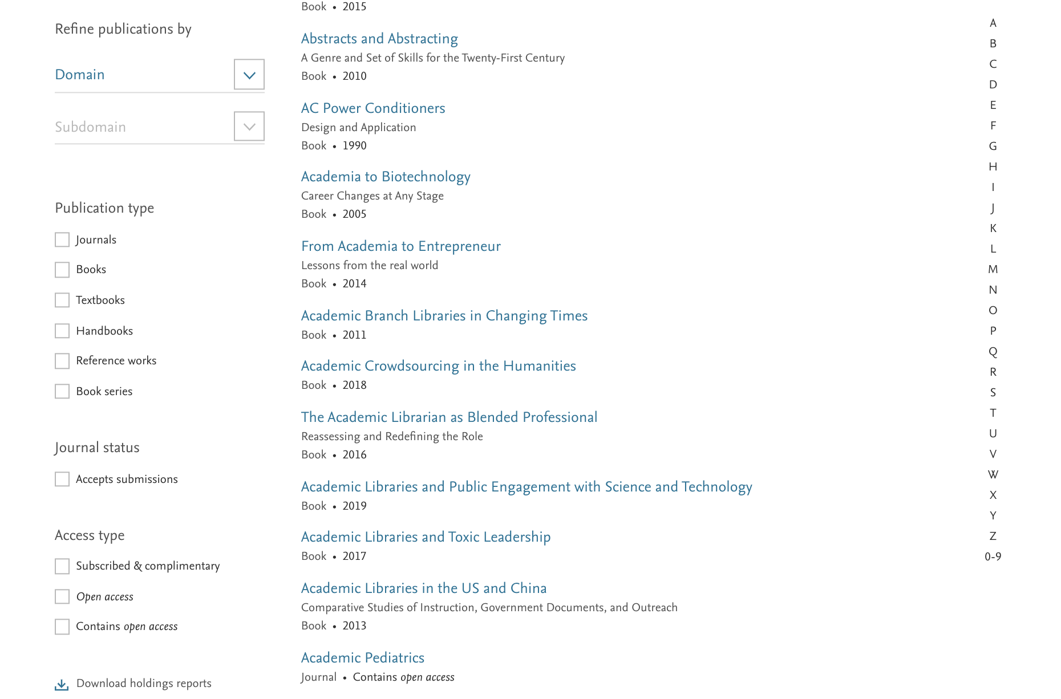
Browse
If you want to begin your ScienceDirect experience by browsing through the content instead of searching, just click on Journals and Books on the homepage.
This modernized browse page has enhanced search capabilities and simpler URL composition.
Refine publications by domain and sub-domain
Select the type of publications
Select journals accepting submissions
Choose the type of access

Slide 7
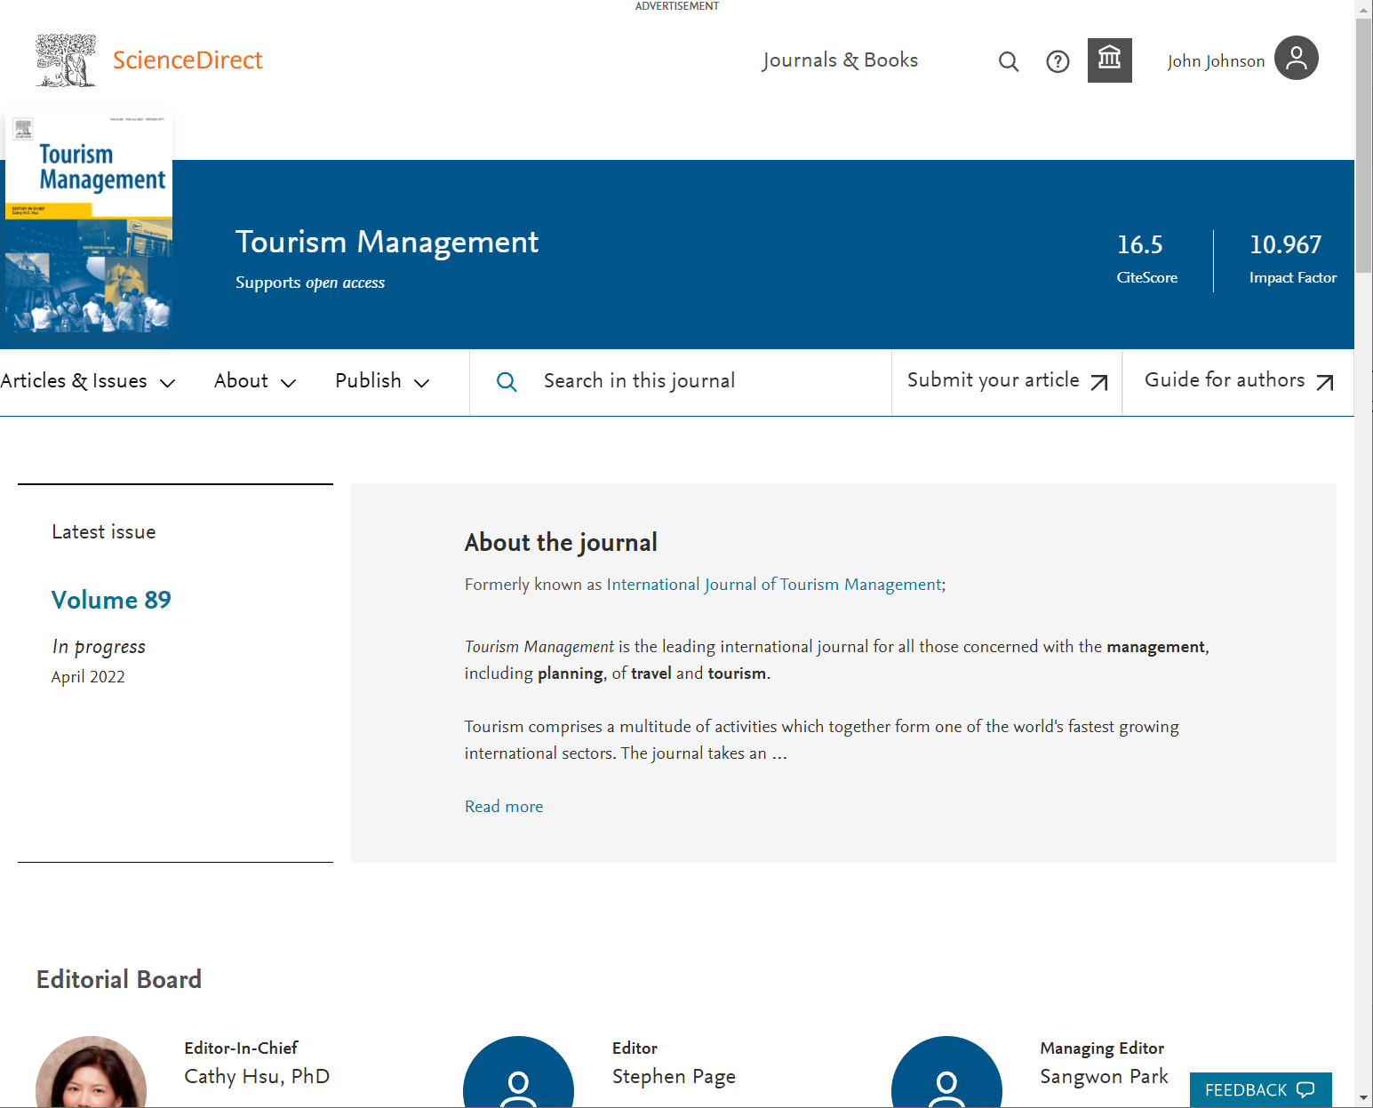
Easy to evaluate journal homepages
When your research takes you to the homepage of a journal, all information about that journal is easily accessible. You spend less time trying to find the right information and more time using what you find in your workflow.
Improved navigation allows you to discover relevant content faster
Access indicators help identify available content, including open access
Easy links to submit your article or find the Guide for author

Slide 8
Clear identity via book homepages
When you access books on ScienceDirect, you’ll see right away that you’re consulting a trusted, high-quality source.
The book homepages include:
Detailed book information
Intuitive ways to navigate and interact with content
One-second load times
Plus, go ahead and browse books on multiple devices wherever you are.
A view of an example Books homepage on desktop, tablet and smartphone

Slide 9
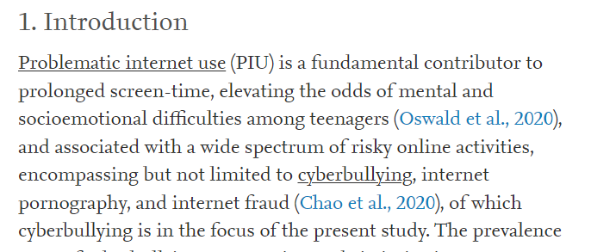
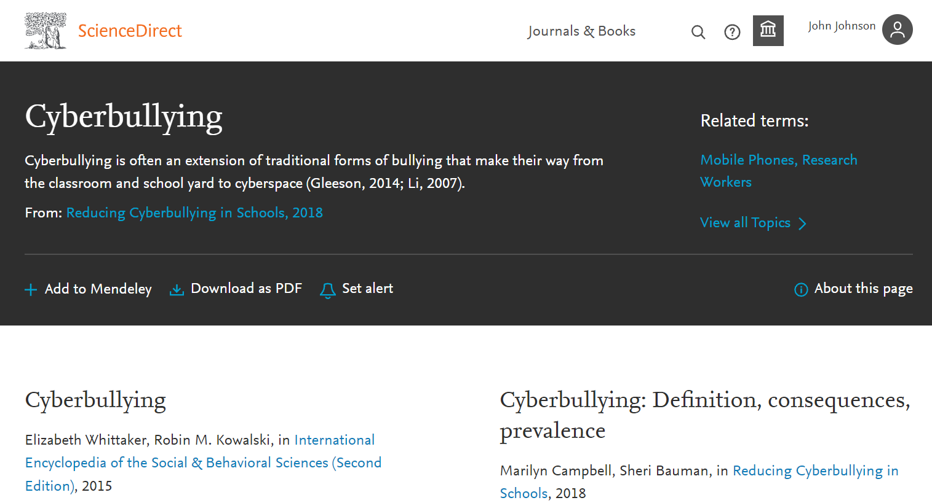
ScienceDirect Topics expand your knowledge with foundational content
ScienceDirect Topics have become a popular feature for researchers and students looking to broaden their understanding of scholarly and technical terms. Topics are especially useful for onboarding in interdisciplinary research or just to learn or better understand a new concept.
Topics reveal succinct, selected contextual information from reference books, valuable content when and where you needed it in your natural research workflow. You can access Topics via ScienceDirect and also through search engines such as Google.
When working in ScienceDirect, simply hover over a highlighted word in the article you’re reading. Via hyperlink, you can immediately go to a page with authoritative and foundational content for that term.

Slide 10
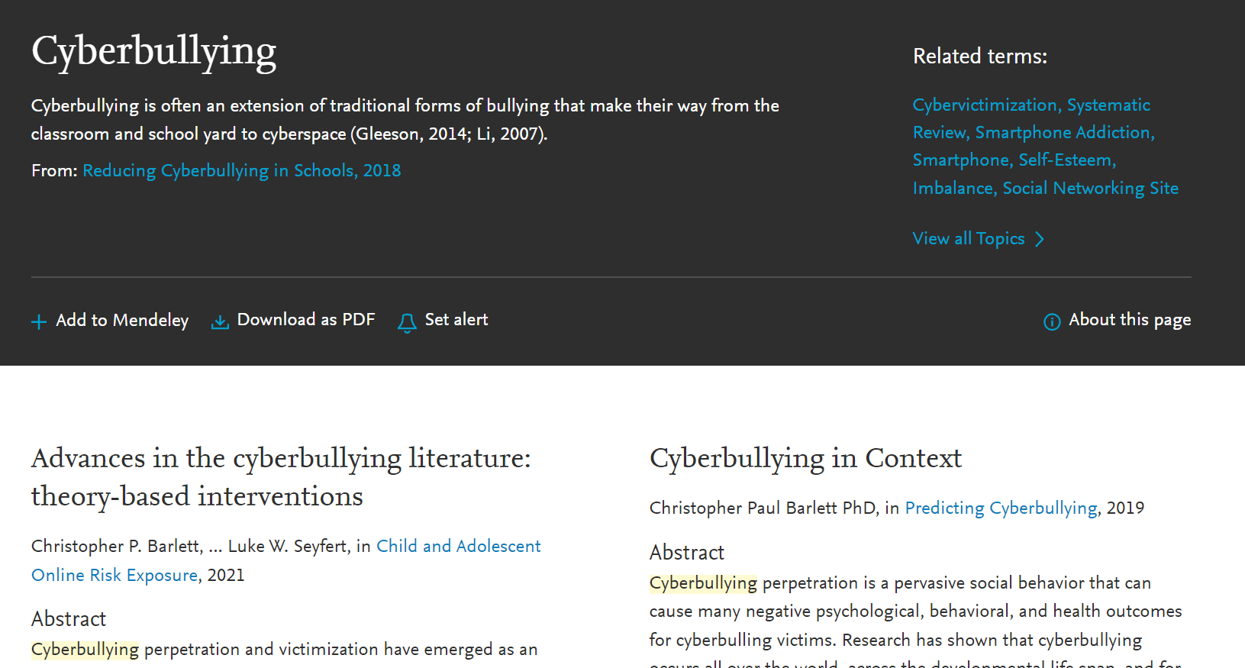
ScienceDirect Topics expand your knowledge with foundational content
You’ll see
A short definition
Related terms
Excerpts from relevant book content
Add to Mendeley, download as PDF or set an alert to save your
sources and unlock critical and contextual information to
find the answers you need.
If you’re using Google or another search engine to get more information about a term, just enter the term and ScienceDirect, and it comes up. With enhanced taxonomy across all 20 Topic domains, Topic pages are available for many disciplines including:
Computer Science
Engineering
Mathematics
Physics and Astronomy
Economics, Econometrics and Finance
Food Science
Materials Science and Materials Engineering
Earth and Environmental Sciences
Psychology
Social Sciences

Slide 11
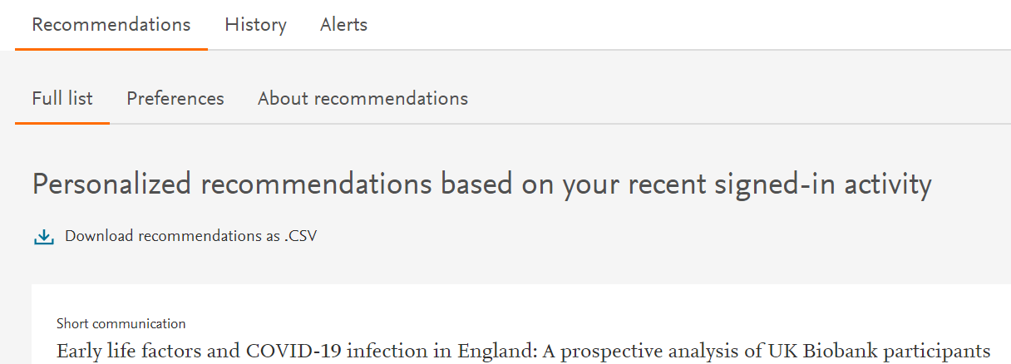
Stay signed in to get personalized recommendations
You can prevent information overload by staying signed in while you browse and search in ScienceDirect. Personalized recommendations will make your research more effective. The more you interact with ScienceDirect while signed in, the more precise and relevant the recommendations become.
Let us help you direct the right content to you when and where you need it during your research process. We’ll use machine learning and your online activity to suggest content tailored specifically to your needs.
On the homepage, click on your name and then 'My recommendations’ to see what our adaptive algorithm has found for you.
My recommendations offers you a complete list of recommended research content each week, delivered to you via email.

Slide 12
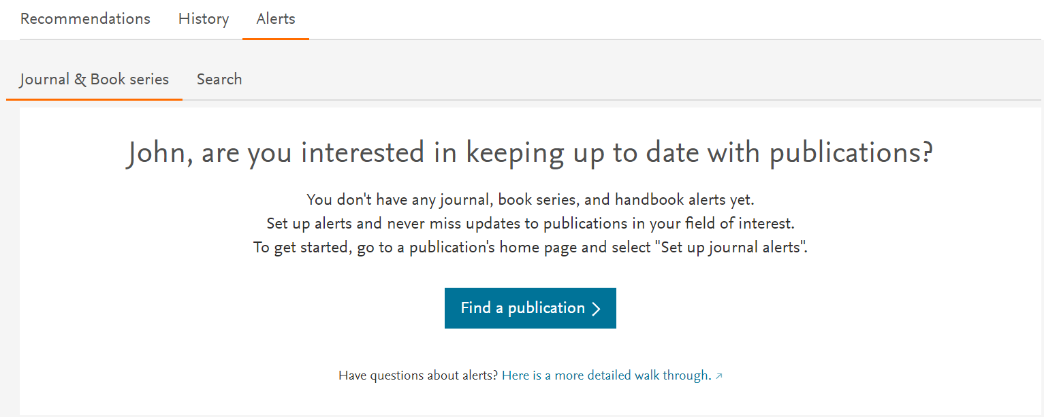
Schedule alerts about new relevant research
Unlike Recommendations, Alerts let you know about only new research that meets your criteria.
Once you’ve either searched in ScienceDirect or browsed publications, you can choose to sign up for alerts. Go to ‘Manage alerts’, then click on either ‘Journal & Book series’, ‘Search’ or both. You can select a publication or carry out a search to set the alerts you want.

Slide 13
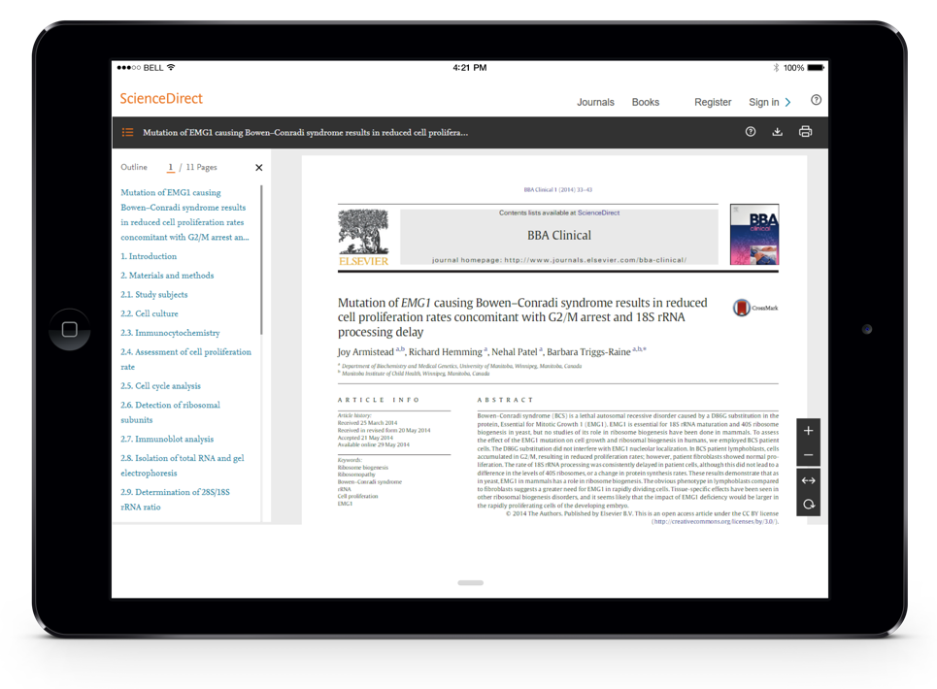
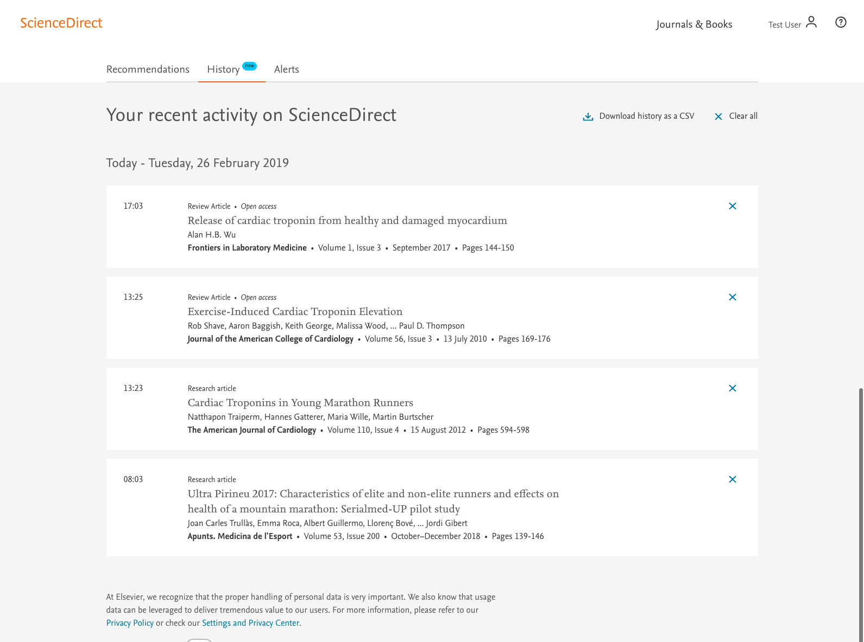
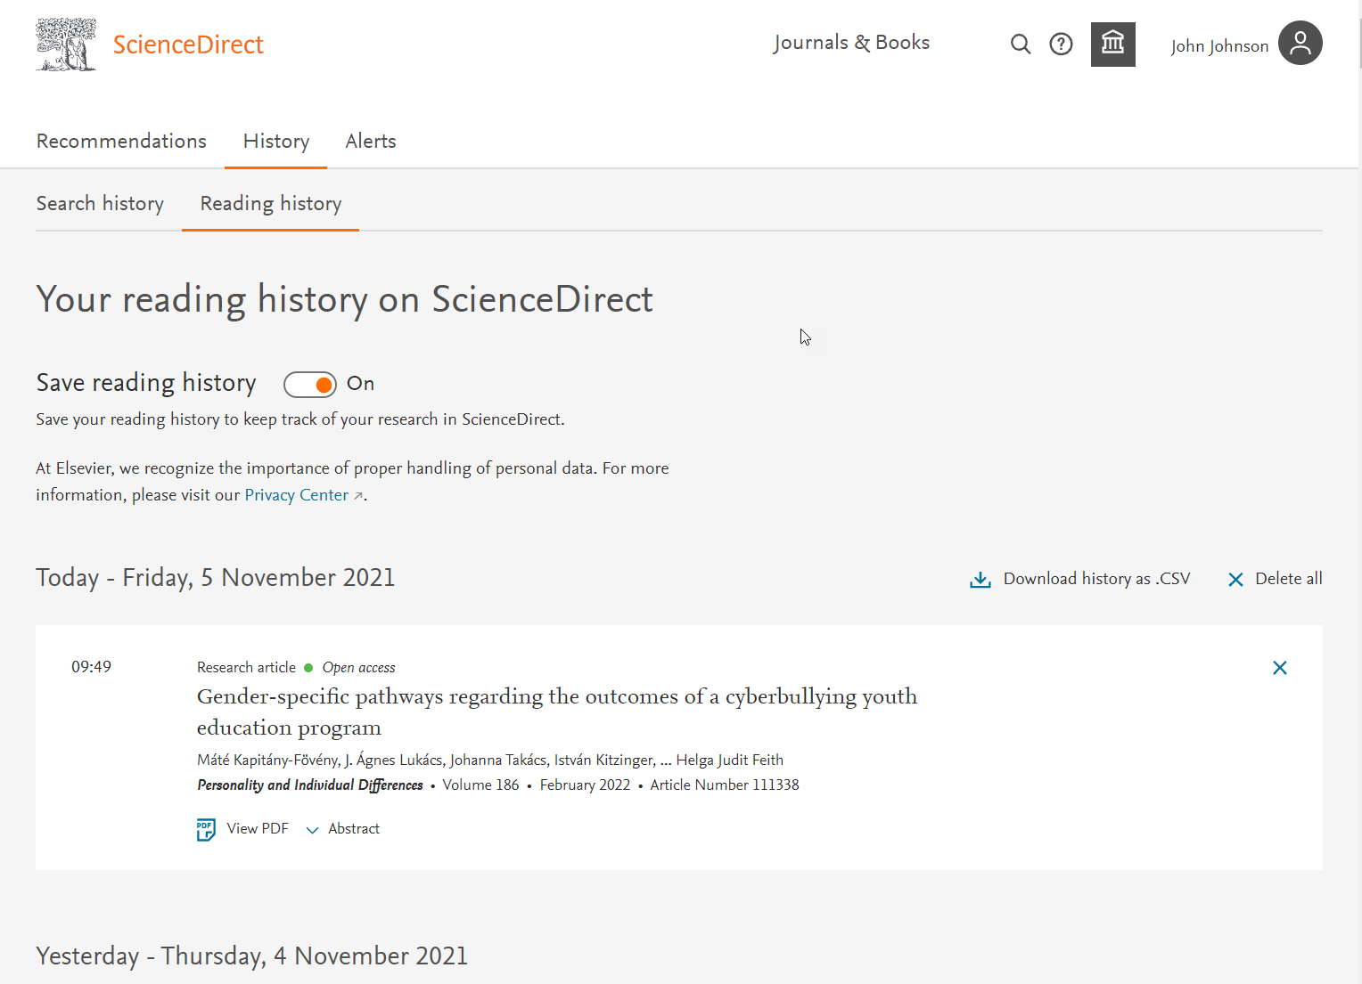
Easier tracking of your reading and search history
When signed in, your Search and Reading history helps you keep track of your activities.
The 100 most recent articles you have viewed will be saved in your reading history.
You can then review, save and delete items from your ScienceDirect Reading or Search history or download the full list of entries.
Use the toggle at the top of the screen to easily switch on and off your history.
Users can manage their reading history and customize settings

Slide 14
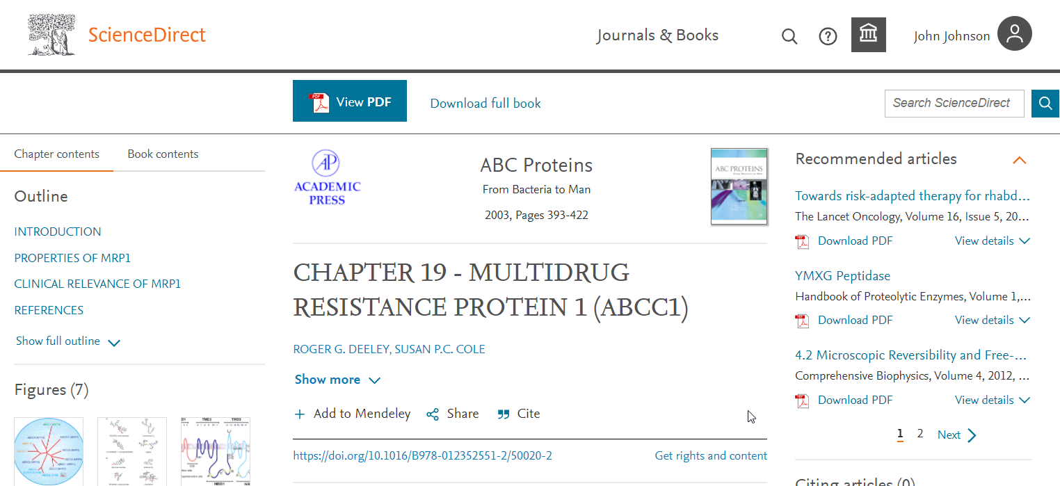
Quickly export your book chapters from ScienceDirect into Mendeley
Many of you also use Mendeley, our free reference manager and an academic social network, seamlessly embedded in ScienceDirect. Knowing that importing PDFs and references from the web is an important part of many researchers' workflow, you can directly export articles from ScienceDirect into your Mendeley library
Once you've been authenticated on ScienceDirect, the Mendeley Importer will recognize that you have the right to access full-text PDFs and you can add to Mendeley with just one click.

Slide 15
Share articles with your colleagues with just a click
Social Sharing allows you to easily share articles right from ScienceDirect via your Facebook, LinkedIn, Twitter, Reddit, or email account.
Just click on the appropriate icon and post what you wish to share. This will allow you to receive feedback on findings and publications more quickly from your collaborators, peers and students, increasing your efficiency during already busy workdays.
Users can share articles with the community

Slide 16
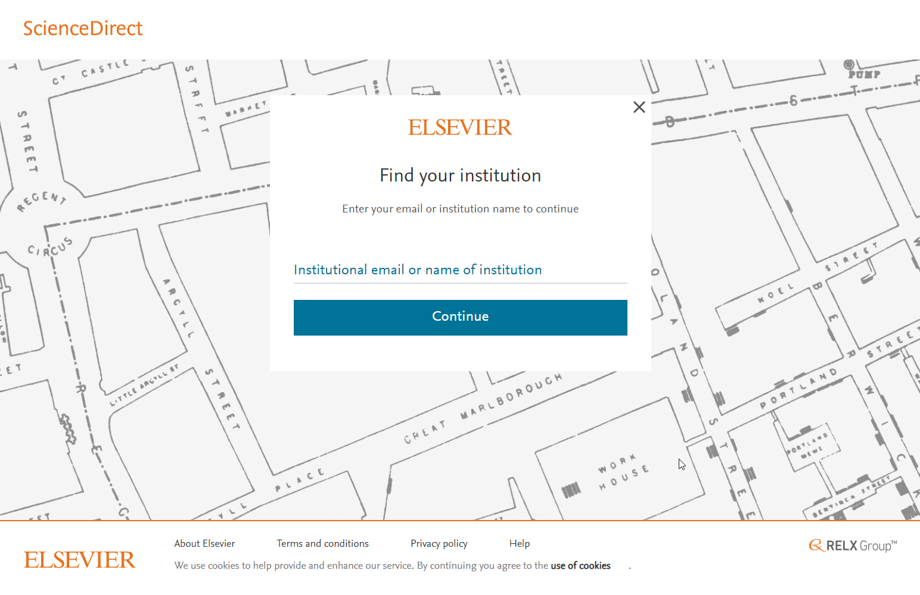
Access ScienceDirect remotely, whenever you want
You can access ScienceDirect anytime and anywhere. On your laptop or tablet, at home or on the road, on campus or off, you can keep your research going by accessing ScienceDirect remotely:
Visit our Institutional access page and enter your institutional email address of the name of your organization.
Once your institution is identified, you can sign in with your institutional credentials.
We’ll send you an email where you’ll click on the ‘Activate my remote access now’ link
You’re ready to use ScienceDirect remotely

Slide 17
A research experience accessible to all
We optimize the ScienceDirect experience for everyone, including people with impairments such as auditory, cognitive, physical, speech or visual.
Our goal is to meet level A and AA guidelines established by the W3C’s Web Content Accessibility Guidelines 2.1 and the U.S. Section 508 Standards of the Federal Rehabilitation Act, as well as similar standards enacted by countries around the globe.
Here are some features that enhance the accessibility of ScienceDirect:
HTML journal articles and book chapters are compatible with screen readers such as JAWS, NVDA and Apple's VoiceOver
Pages are well structured using headings, landmarks and lists so users of assistive technology can easily jump around pages
Math content is available in MathML, which can be spoken by text-to-speech engines or converted to Braille and pasted into math equation editors or Microsoft Office documents
Pages employ ARIA (Accessibility for Rich Internet Applications) to enhance navigation, orientation and labeling for users of screen readers and other assistive technology
Videos are played in a fully accessible media player (AblePlayer)
For more information on ScienceDirect accessibility, or for accessibility related feedback and support, please refer to our accessibility statement

Slide 18
Security is important to you and us
We're more proactive than ever in preventing security breaches - and taking quick action if any occurs. Monitoring and communication are fundamental in keeping your interaction with ScienceDirect as secure as possible:
We monitor on a 24/7 basis and block the session IP if we detect abnormal behavior
We get in touch with you and ask you to investigate the particular IP
If solved, we unblock the IP
ScienceDirect is also available via HTTPS

Slide 19
Seek help when you need it
Our ScienceDirect Support Center can answer your frequently asked questions and offers video tutorials and other user guides.
You can access the ScienceDirect Support Center by clicking the Help button in the upper right corner of the ScienceDirect pages or by following the link above. Now also available in Chinese and Japanese!
Click the question mark button to link to the Support Center
Stay up to date with product enhancements here.

